Slide 1

<Insert Hack Name Here>
Notes:
This deck is a template for What The Hack lectures.
It is recommended that Coaches deliver mini-lectures ahead of each Challenge that set context for the challenge and introduce & explain any key technologies.
At a minimum, it is handy to have a slide with the key goals of each challenge to display on the screen when running the hack in-person.

Slide 2

Dynatrace on Azure
Modernize and Monitor Applications with Dynatrace on Azure

Slide 3
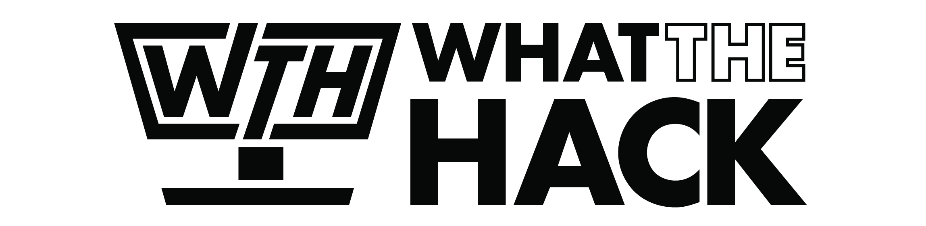
Dynatrace on Azure
Welcome & Intros
<Coach Name>
<Coach Name>
<Coach Title>
<Coach Title>
<Coach Name>
<Coach Name>
<Coach Title>
<Coach Title>
Notes:
Coaches/Presenters for THIS hack/lecture event should be listed on this slide.
Original contributors to the hack content & these slides include:
Please list original contributors to this hack here in the speaker notes and give them credit when delivering this content.
<Original Author 1>
<Original Author 2>
…
<Original Author N>

Slide 4
Workshop Objectives
​
Common challenges associated with modernization​
How to solve challenges of hybrid cloud with Dynatrace observability​
Improve acceleration of cloud workload adoption of Azure

Slide 5
Dynatrace & Microsoft

Slide 6
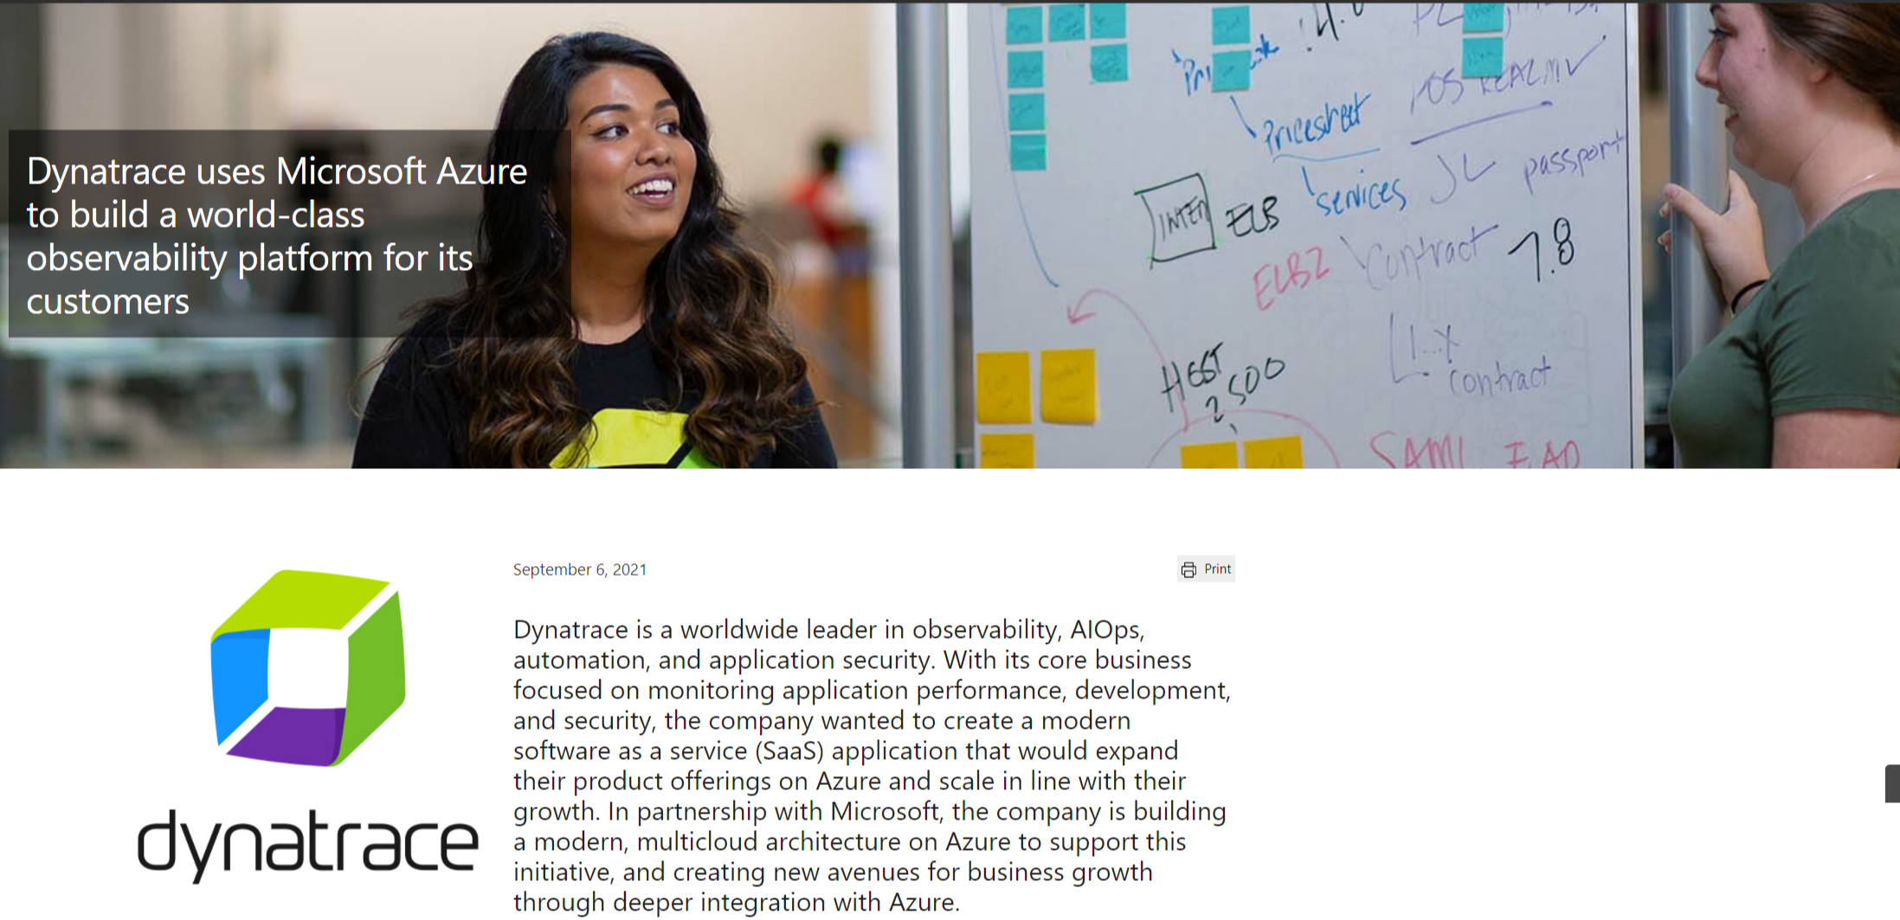
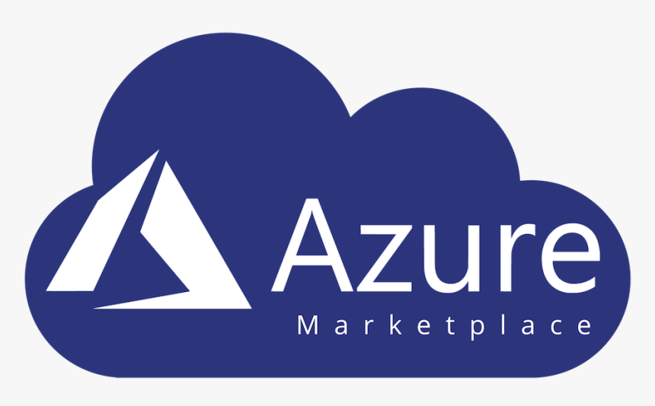
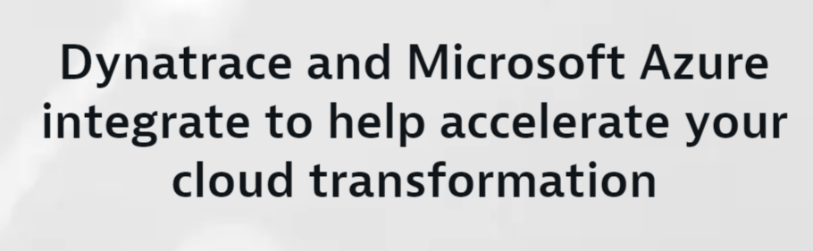

Well-Architected Framework
Cloud Adoption Framework
Marketplace Transactable: Decrement Azure Commit (MACC)
Silver Data Analytics and Data Platform Competency
Azure Native Dynatrace Service
Gold Application Development Competency
Dynatrace and Microsoft

Slide 7









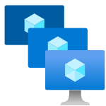
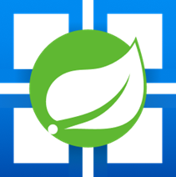



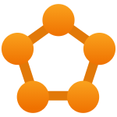

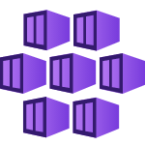
Out of the box support for Azure cloud native architectures
Ever growing support for Azure services
Real-time observability into dynamic environments​
With automatic instrumentation for dynamic microservices and unique hybrid support, Dynatrace monitors your entire cloud including all dependencies in real time with no blind-spots. Dynatrace OneAgent supports byte-code instrumentation for Azure App Service, Web Apps, Azure VMs, Azure Functions, Azure Spring Cloud, Azure Kubernetes Service, Azure VM Scale Sets.
Azure Cognitive Services
Azure Application Gateway
Azure Batch
Azure Blob Storage
Azure Cosmos DB
Azure DB for Maria DB
Azure SQL
Azure Managed SQL
Azure Functions
Azure VM Scale Sets
Azure Spring Cloud
…and many more!
Azure Load Balancer
Azure Machine Learning
Azure Data Lake
Azure Service Fabric
Azure App Service
Azure Kubernetes Service

Slide 8
Cloud Modernization Challenges

Slide 9







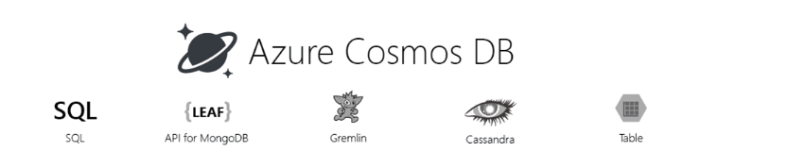
Your Modernization Journey
Move to the Cloud
Containerize Applications
Move-to-Serverless
Build with Cloud-Native
Apps / DBs run on VMs
No code changes
Develop & deploy faster
Application portability
No code changes
License freedom/savings
Performance improvement
Cross-platform support
Microservices-based
Serverless architecture
DevOps model
Applications
Azure Service Fabric
Container Instances
Azure Kubernetes Service
Azure Functions
Azure API Management
Azure App Services
Azure VM
Azure VM Scale sets
VMs ➤ Containers
Azure Functions
Azure Storage Account
Azure CosmosDB
Managed Databases
Move-to-Open Source
Customer operates everything above the infrastructure
Managed provisioning, backups, patching, monitoring & scaling
No code changes
High performance & scalability
Purpose-built database services
License savings
Databases
Azure API Management
Azure Kubernetes Service
Azure
Cosmos DB
Azure MSSQL Managed
On-Prem ➤ Cloud Native
Self-Serve ➤ Managed
Purpose-Built
Build New
Notes:
Your journey in Azure won’t have a finish line
Azure cloud continues to grow and so will their service offering
Your cloud migration will continue to evolve as newer faster, more efficient services are released
Dynatrace will continue to your support and optimize those cloud native services

Slide 10
Modernization Journey & Cloud Adoption Framework Benefits
Automated CI/CD pipeline – data-driven decisions and experiments
Innovation Velocity
DevOps model
AI/ML
Monoliths to microservices,
purpose-built DBs
HW/SW right-sizing
COTS → open source
Offload operational activities
Managed services
Cost of compute and storage
Automation tools
Containers/ serverless
Cost of compute and storage
On premises
Lift and shift
Cloud-native optimized
Cloud-native Optimized
Notes:
The Journey of a thousand miles…
Your first workloads will typically be lift and shift
This will lead to optimization & right sizing exercises
Then automation, new commercial & open source software will begin to drive this transformation forward
This is the most pivotal moment in this journey

Slide 11















Digital
Cloud
experience
automation
Applications &
Mobile, web browser,
microservices
and API
Closed-loop
remediation
Infrastructure
monitoring
Feature adoption
Hybrid cloud
analysis
Quality gate, service
Observability is growing fast
distributed tracing
level, and delivery
Hybrid cloud
Fault domain
observability
isolation
Visual session
Automatic
replay
code-level root cause
DevOps, SRE
Serverless, container,
Application
lifecycle
pod & network
and profiling
security
Digital
business
The importance of observability is increasing, use cases are more diverse, and “observe everything” is the mindset
Frontend & backend
Run-time
availability and
vulnerability detection
performance
Real-time business
insights
Impact analysis
Impact and
DevSecOps
conversion
automation
BizDevOps
integration and
automation

Slide 12

This creates challenges
Metrics
The volume, variety, and velocity of data will exceed the scalability of the observability solutions
Finding answers and root cause will be impossible with human-powered correlation – automated answers and causation are required
Sessions
Logs
Traces
… and more

Slide 13
What the hack environment setup

Slide 14
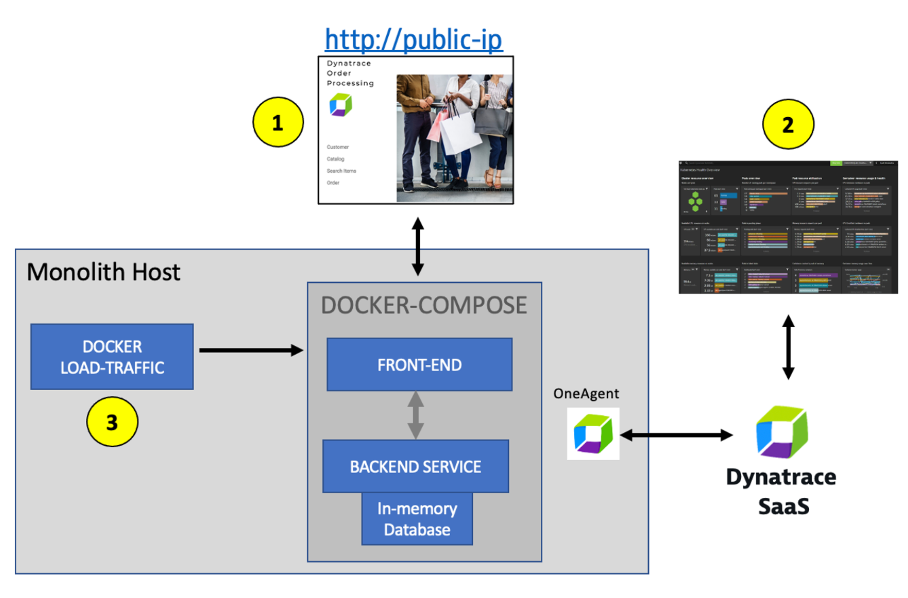
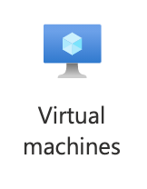

Workshop Environment for Monolith VM

Slide 15
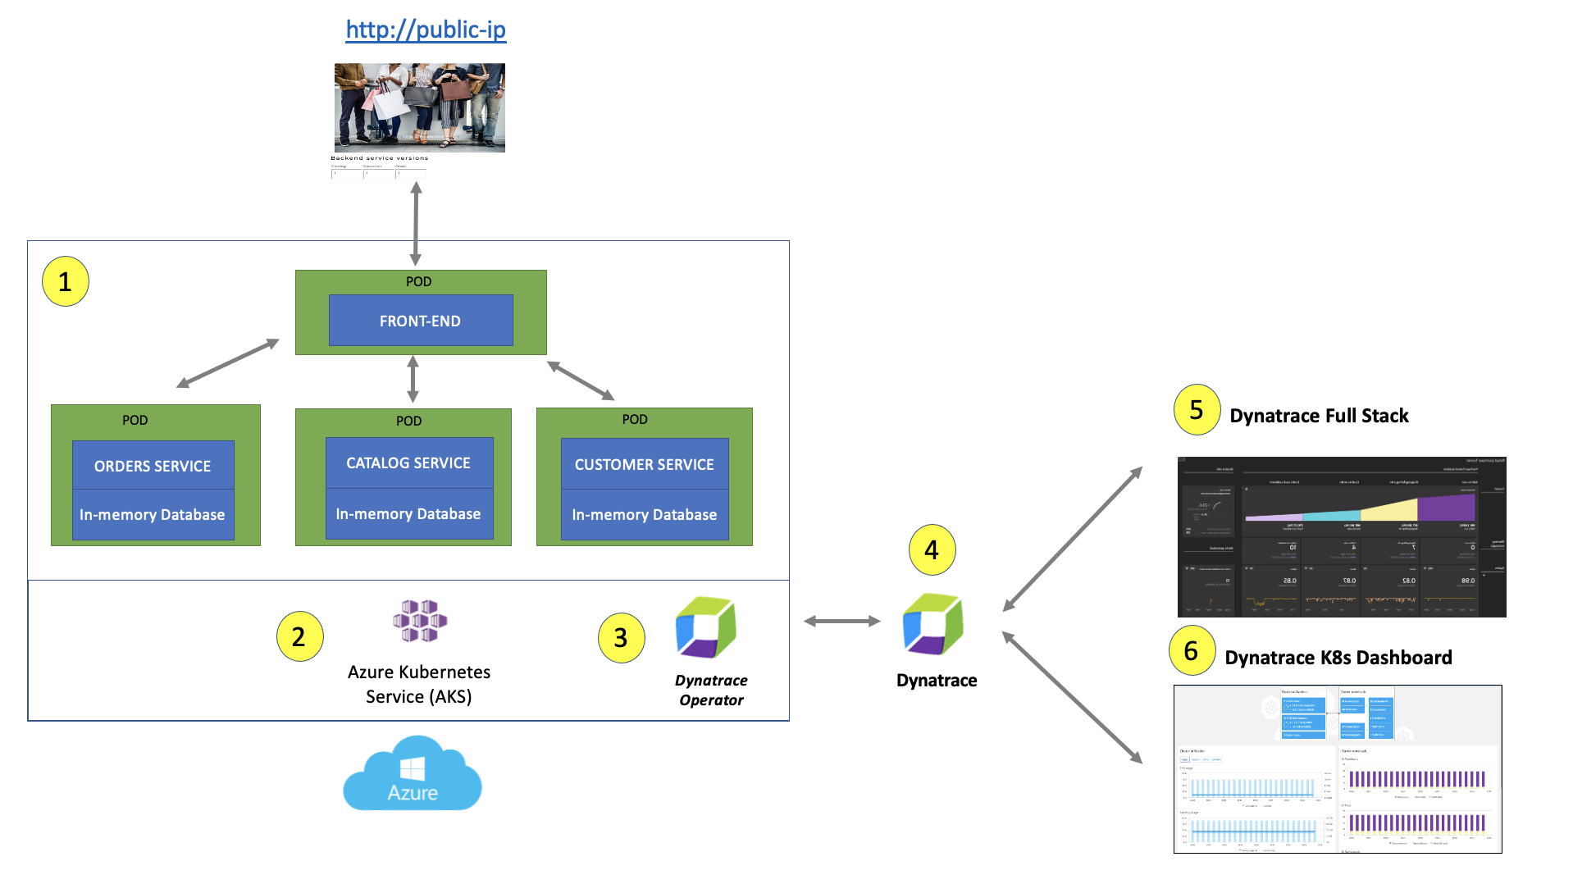
Workshop Environment for AKS

Slide 16

Challenge Zero Get your machines ready!
Sign up for Azure Free Trial Account
Sign-up for free Trial of Dynatrace
Install the Azure CLI (in WSL if on Windows!)
Install PowerShell Cmdlets for Azure
Notes:
Modify this slide and add the pre-reqs specific to your hack here.
Each challenge slide should list the key goals for the challenge.

Slide 17

Challenge 1 - Dynatrace Observability on Azure VM
Notes:
For each “mini-lecture”, have a topic title and/or sub-topic title.
Each mini-lecture should be no longer than 5-10 minutes in length.
Only deliver one lecture ahead of each challenge.
Do not attempt to present all of the lectures before students start hacking.

Slide 18
Challenge #1 Dynatrace Observability on Azure VM
Review Dynatrace OneAgent data
Review data on host view
Review SmartScape view
Review Service Flow view
Review Service Back trace view
Review Database view
Review Technologies view
Review real-time data available for the sample application
Pull up a distributed trace and perform a multi-dimensional analysis
Review how Dynatrace helps with modernization planning
Notes:
For each challenge, list out the key high-level goals.
If there are important specifications, list them here, or remind students to “read the student guide!”

Slide 19
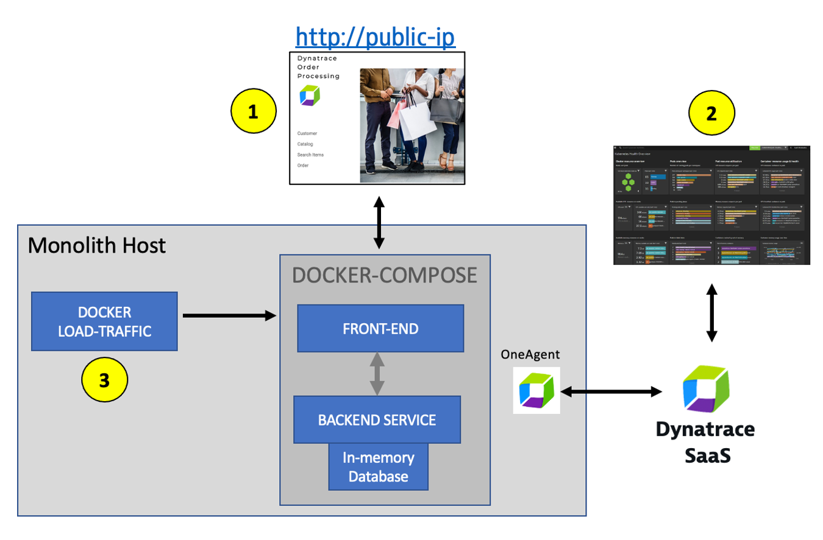
Dynatrace Observability on Azure VM
Notes:
Template for a lecture slide with bullets (if you need them).
Try to NOT use bullet lists in your presentation.
Diagrams, puppy pictures, etc are always better. ☺ ---notes---- * While choosing the right migration strategies, such as re-hosting or re-architecting, one must assess the different risks, costs, and benefits. However, often the details of what is where and what is dependent on what within the technical stack is missing or poorly documented. All that may exist is out of date diagrams and a mix of monitoring tool metrics that must be "stitched" together.
* Not having enough details about the current environment is hindering organizations ability to make the right decisions when planning what to migrate and when.
* To address this problem, Dynatrace’s OneAgent can automatically discover the application, services, processes and to build a complete dependency mapping for the entire application environment. So, let’s begin!

Slide 20
Challenge 2 – Dynatrace Observability on AKS
Notes:
For each “mini-lecture”, have a topic title and/or sub-topic title.
Each mini-lecture should be no longer than 5-10 minutes in length.
Only deliver one lecture ahead of each challenge.
Do not attempt to present all of the lectures before students start hacking.

Slide 21
Challenge #2 Dynatrace Observability on AKS
Deploy the Dynatrace Operator for Kubernetes
Deploy the sample application on Kubernetes
Analyze sample application on Kubernetes
Notes:
For each challenge, list out the key high-level goals.
If there are important specifications, list them here, or remind students to “read the student guide!”

Slide 22
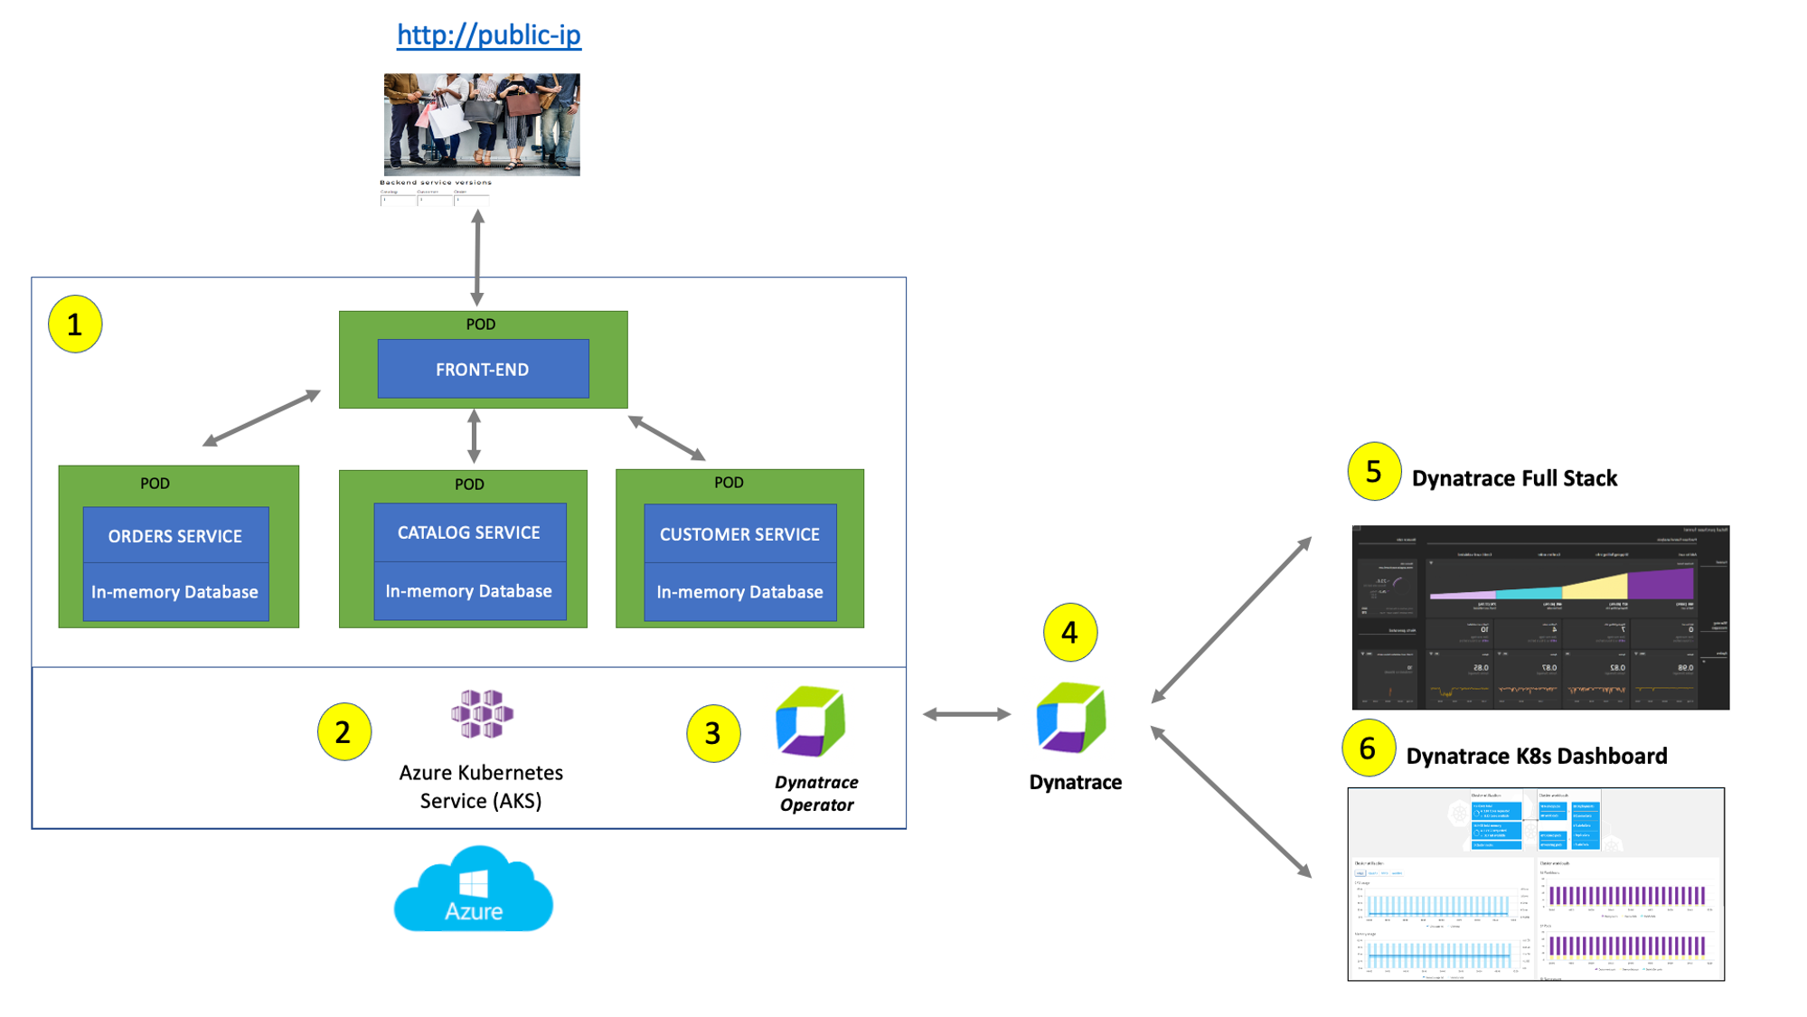
Dynatrace Observability on AKS
Notes:
Template for a lecture slide with bullets (if you need them).
Try to NOT use bullet lists in your presentation.
Diagrams, puppy pictures, etc are always better. ☺

Slide 23
Challenge 3 - Automated Root Cause Analysis with Davis®️
Notes:
For each “mini-lecture”, have a topic title and/or sub-topic title.
Each mini-lecture should be no longer than 5-10 minutes in length.
Only deliver one lecture ahead of each challenge.
Do not attempt to present all of the lectures before students start hacking.

Slide 24
Challenge 3 Automated Root Cause Analysis with Davis®️
Enable a problem pattern in same application on monolith
Review what Dynatrace Davis®️ AI found as root cause to the issue on VM
Enable a problem pattern on sample application on AKS
Review what Dynatrace Davis®️ AI found as root cause to the issue on AKS
Notes:
For each challenge, list out the key high-level goals.
If there are important specifications, list them here, or remind students to “read the student guide!”

Slide 25
Challenge 4 – Azure Monitor Metrics & Custom Dashboard
Notes:
For each “mini-lecture”, have a topic title and/or sub-topic title.
Each mini-lecture should be no longer than 5-10 minutes in length.
Only deliver one lecture ahead of each challenge.
Do not attempt to present all of the lectures before students start hacking.

Slide 26
Challenge 4 Azure Monitor Metrics & Custom Dashboards
Review how Dynatrace integrates with Azure monitor
Review how Azure monitor metrics can be configured as Metric events for alerts
Create a custom dashboard with SLOs
Examine Dynatrace Service Level Objectives (SLOs)
Notes:
For each challenge, list out the key high-level goals.
If there are important specifications, list them here, or remind students to “read the student guide!”

Slide 27
Challenge 5 – Cleanup
Notes:
For each “mini-lecture”, have a topic title and/or sub-topic title.
Each mini-lecture should be no longer than 5-10 minutes in length.
Only deliver one lecture ahead of each challenge.
Do not attempt to present all of the lectures before students start hacking.

Slide 28
Challenge 5 Cleanup
Cleanup your environment if you’re all done!
Notes:
For each challenge, list out the key high-level goals.
If there are important specifications, list them here, or remind students to “read the student guide!”

Slide 29
Thank You for Attending! https://aka.ms/wth
Notes:
Thank students for attending and share the link to the What The Hack website with them.

